Slide 1
Unternehmen im Visier von Cyberkriminellen
Ivano Somaini, Compass Security Schweiz AG

Slide 2
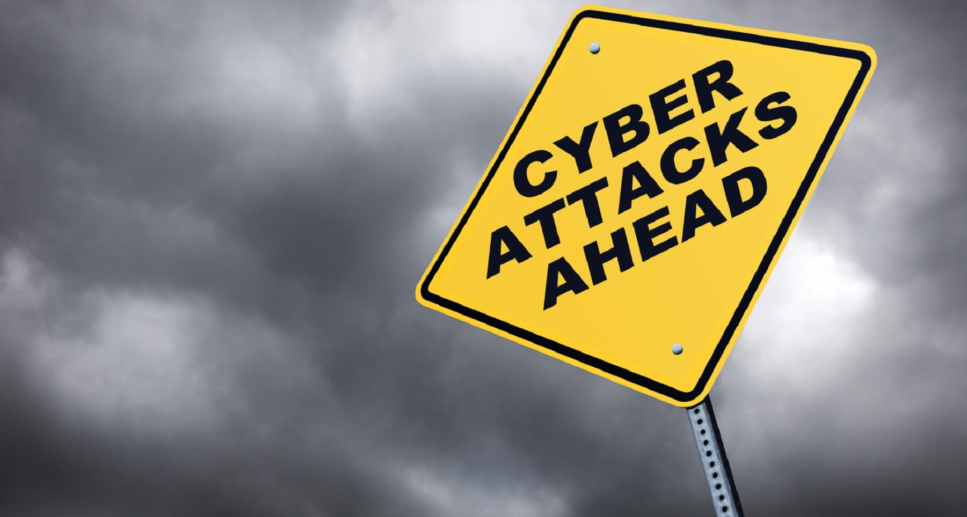
Unternehmen im
Visier von Cyberkriminellen
Live Hacking Demo
Ivano Somaini, Regional Manager Zürich Compass Security Schweiz AG

Slide 3



Slide 4

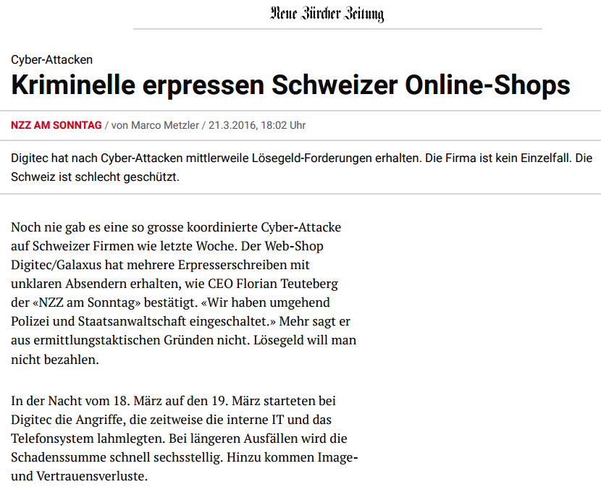
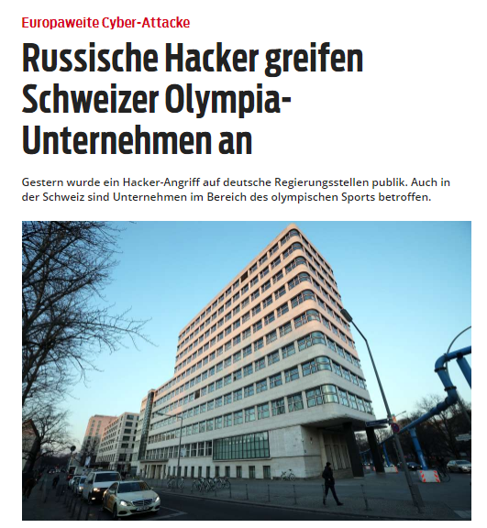
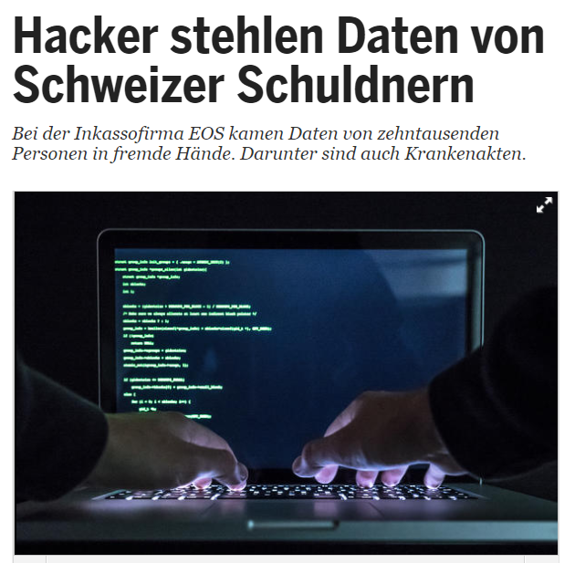
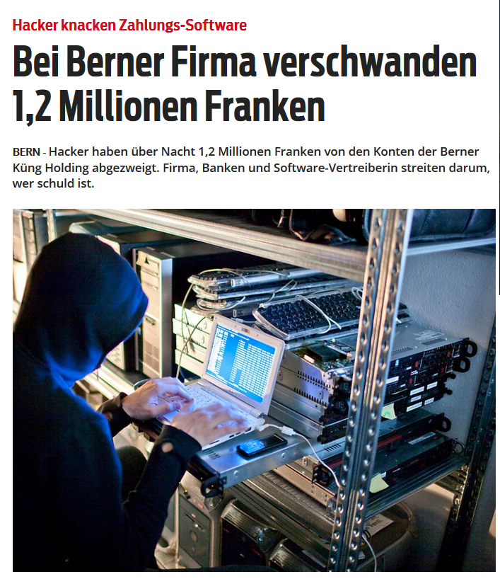
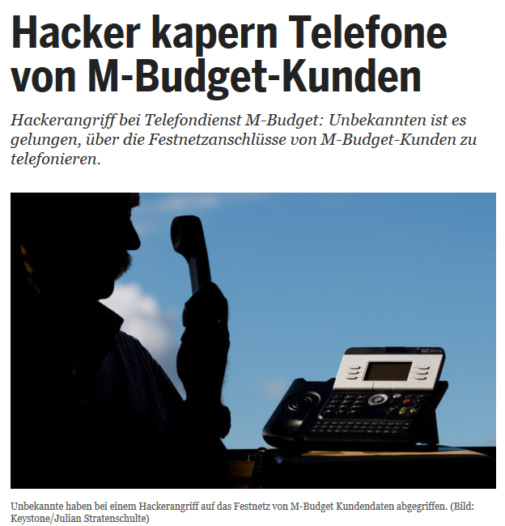
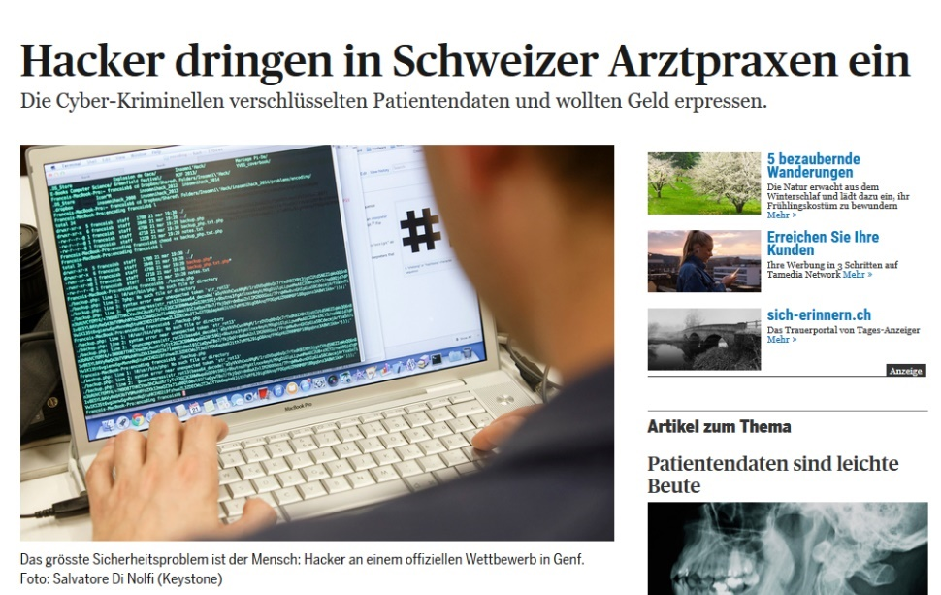
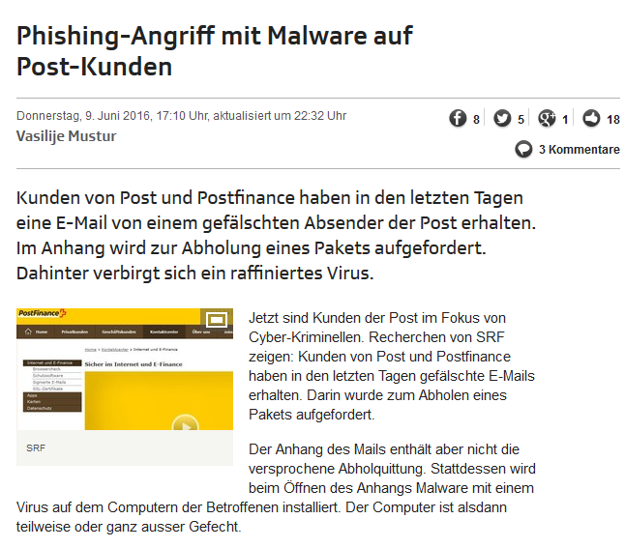
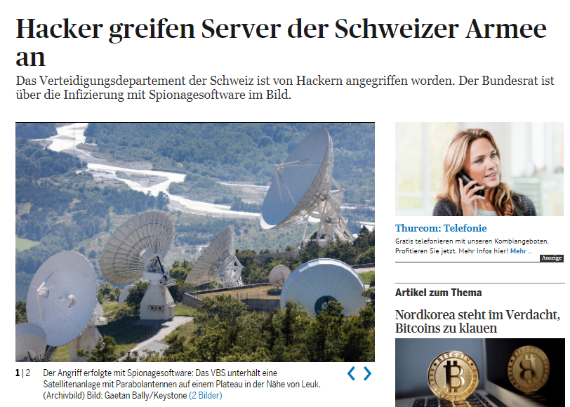
Cybercrime is Here and Now!

Slide 5

$ 445’000’000’000

Slide 6
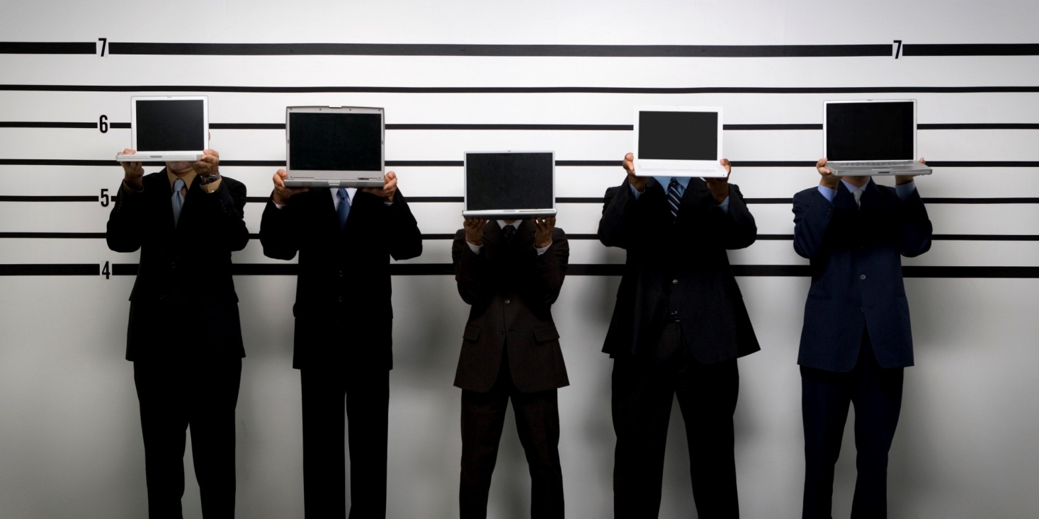
Who are
the Hackers?

Slide 7

Script-Kiddie / Disgruntled Employee
Age
9 – 18 years
Impact
Low
Motivation / Purpose
For fashion, it’s cool, to boast and brag
To give vent of their anger, attract mass-media attention

Slide 8

Black Hat / White Hat
Age
15 – 50 years
Impact
Medium
Motivation / Purpose
To demonstrate their power, attract mass-media attention
For curiosity (to learn) and altruistic purposes
For curiosity (to learn) and egoistic purposes

Slide 9

Organized Crime / Nation State
Age
18 – 50 years
Impact
High
Motivation / Purpose
For profit
Espionage/Counter-Espionage, Activity-Monitoring
Monitoring, Controlling, Crashing Enemy Systems

Slide 10


Slide 11
Why Attack Me?
Untargeted, Mass Attacks
Random targets
Weakest victims (e.g. simple passwords)
E.g. spam, phishing, etc
Unpatched systems
Targeted Attacks
Efficient
Usually combined with social engineering
High success rate
Intermediate Targets
In the Cross Fire of the attacker and his primary target

Slide 12

Cybercrime
Organization

Slide 13
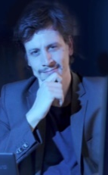

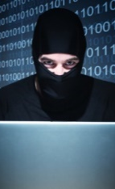
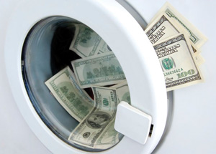


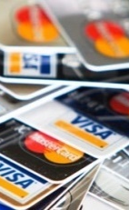
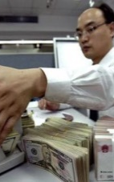
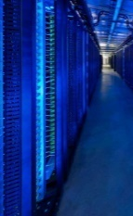

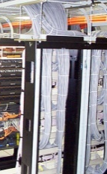
Cybercrime Supply Chain
Organization Leaders
Manage the team and define the goals/targets
Coders
Program the malwares
Hackers
Look for and exploit vulnerabilities in programs and networks
Money Mules
Transfer the money using electronic and/or physical channel
Distributors
Buy and sell stolen data
Fraudsters
Target potential victims with social engineering techniques like phishing
Tellers
Wash the illegal incomes through transfer to digital financial services
Tech Experts
Monitor, repair and grow the infrastructure of the criminal enterprise
Cashiers
Control the hacked accounts and deliver credentials to other criminals against payment
Hosted System Providers
Host illegal servers

Slide 14
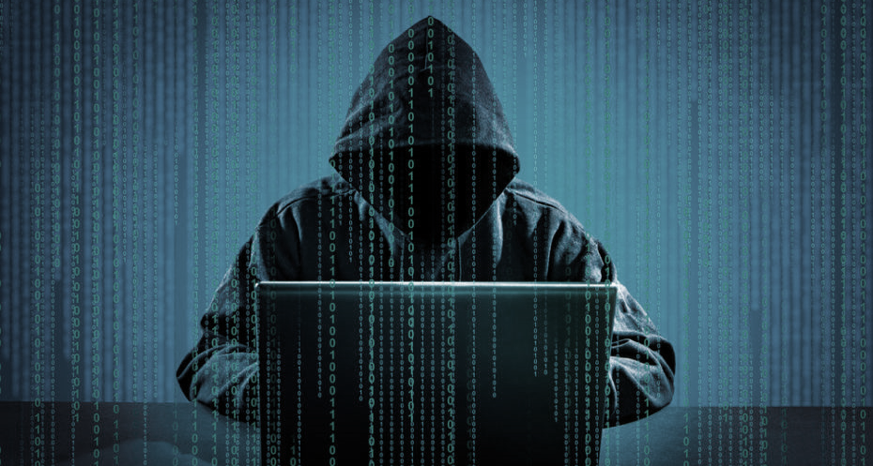
Live Hacking Demos

Slide 15
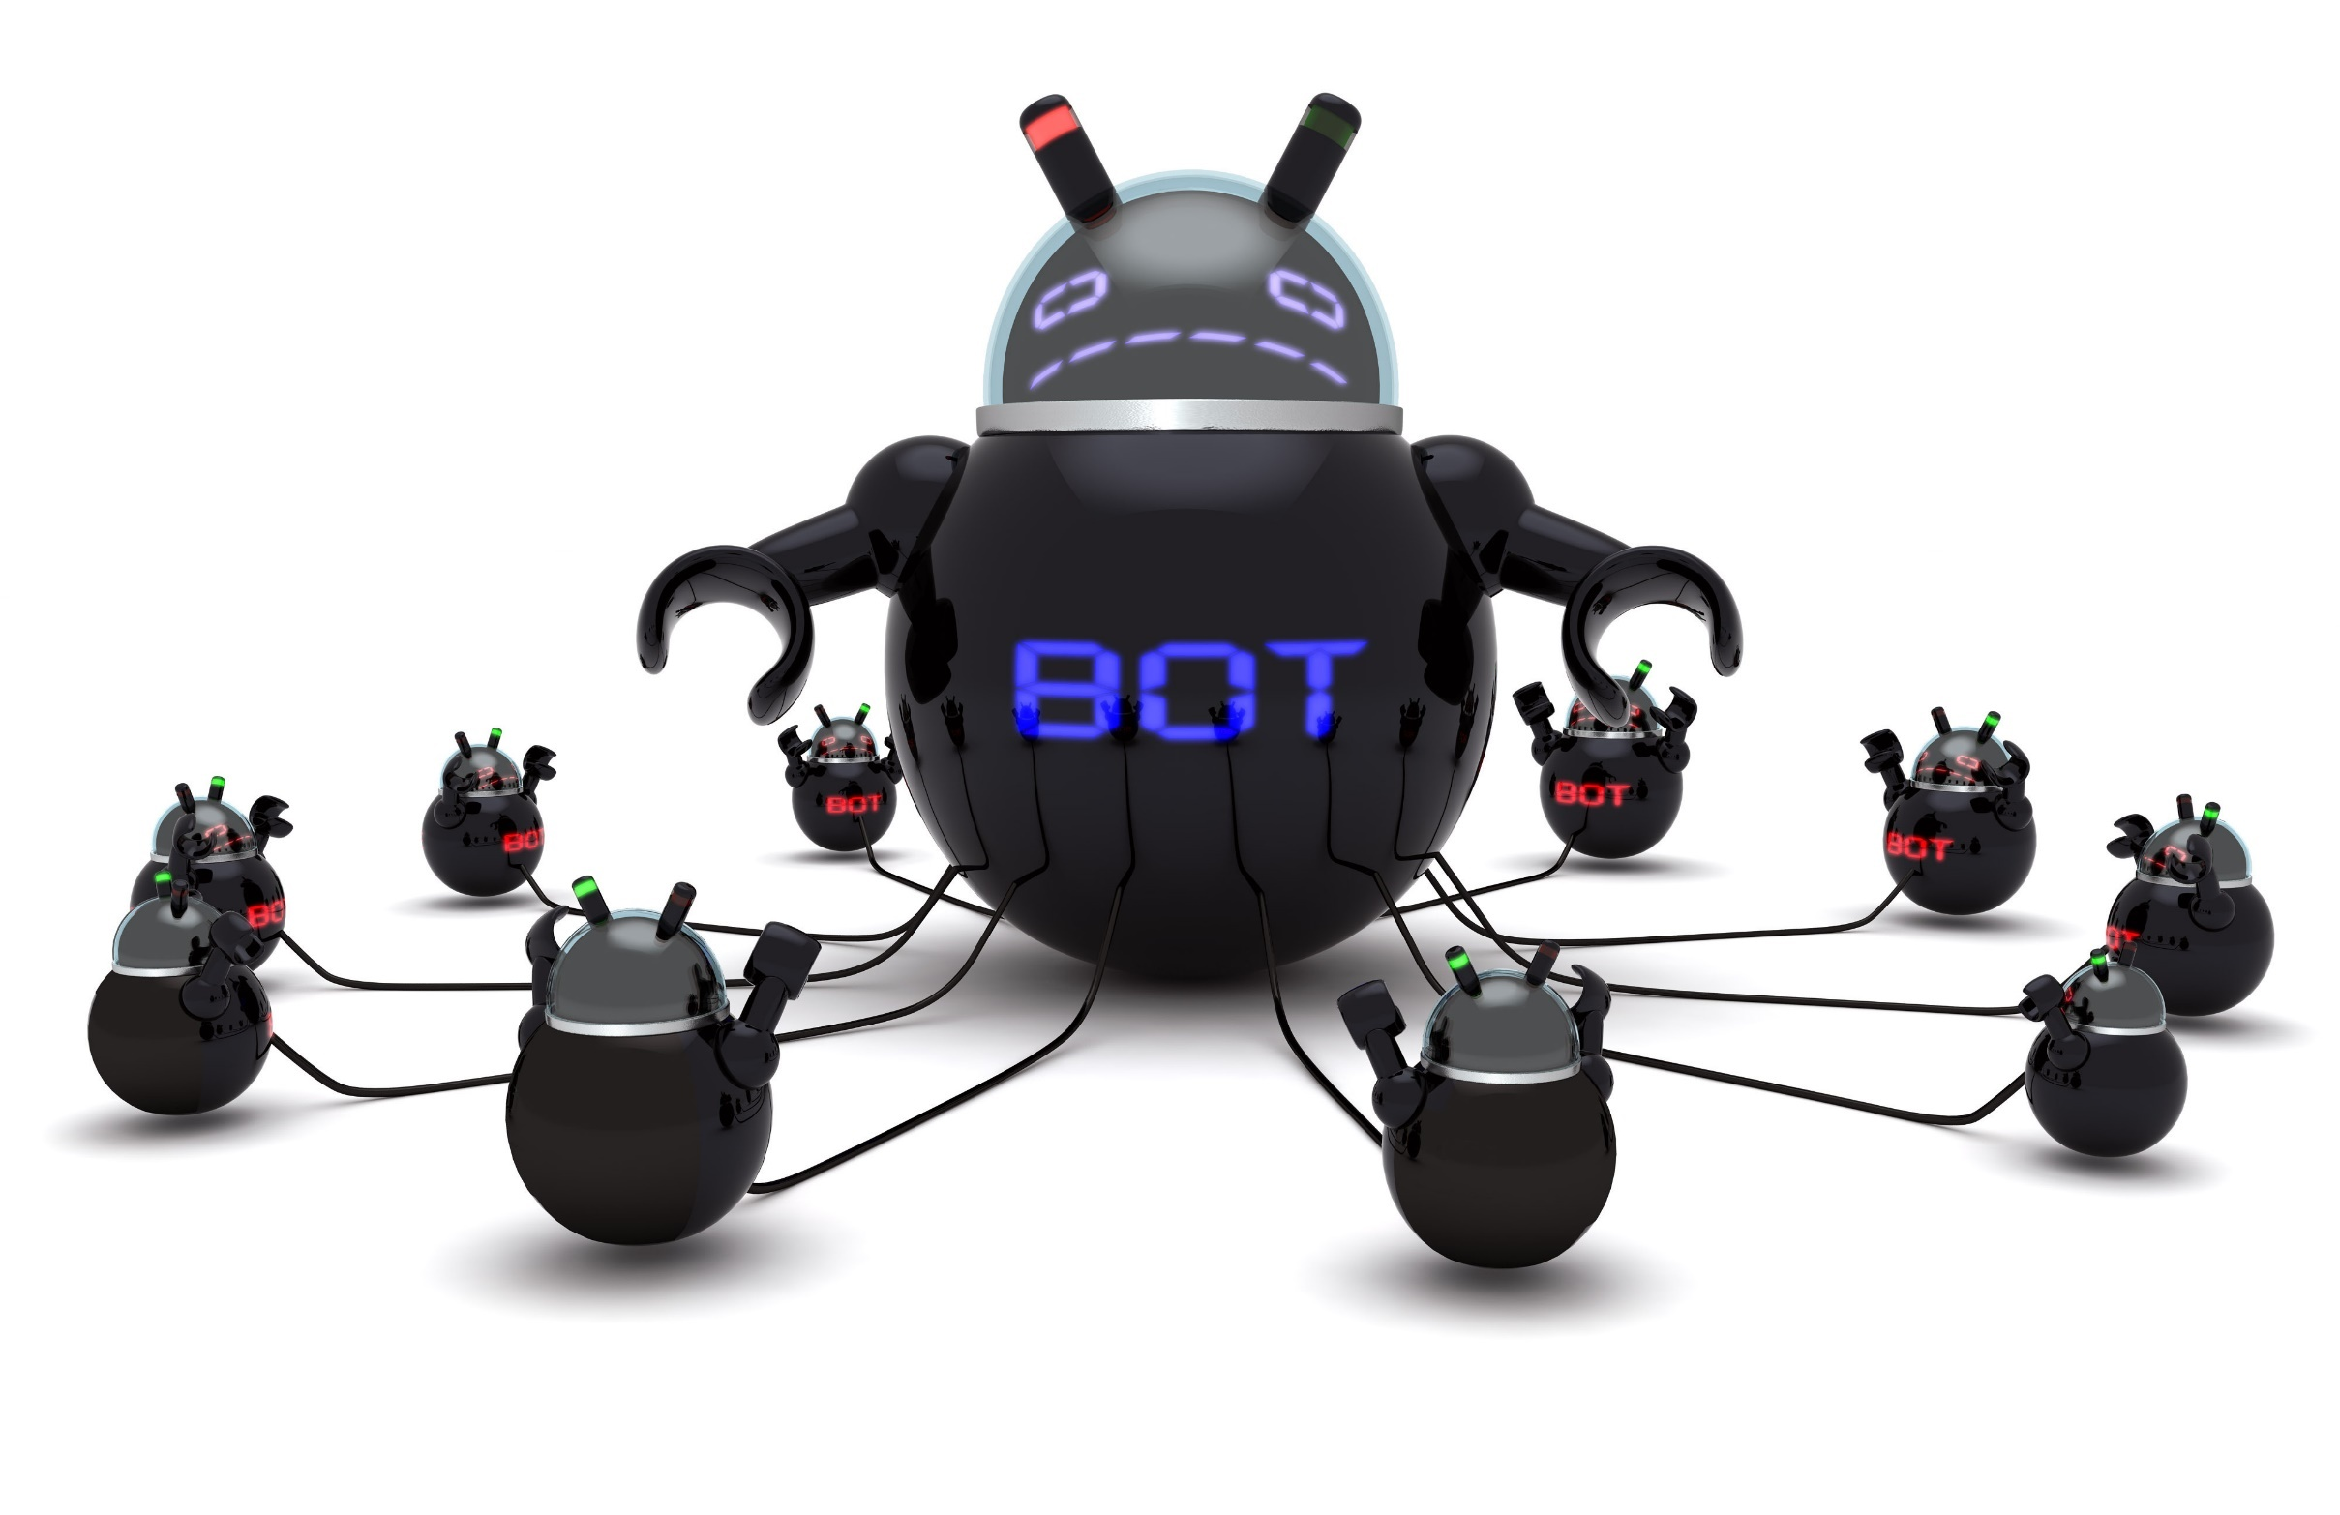
DDoS
A huge army
of small devices

Slide 16
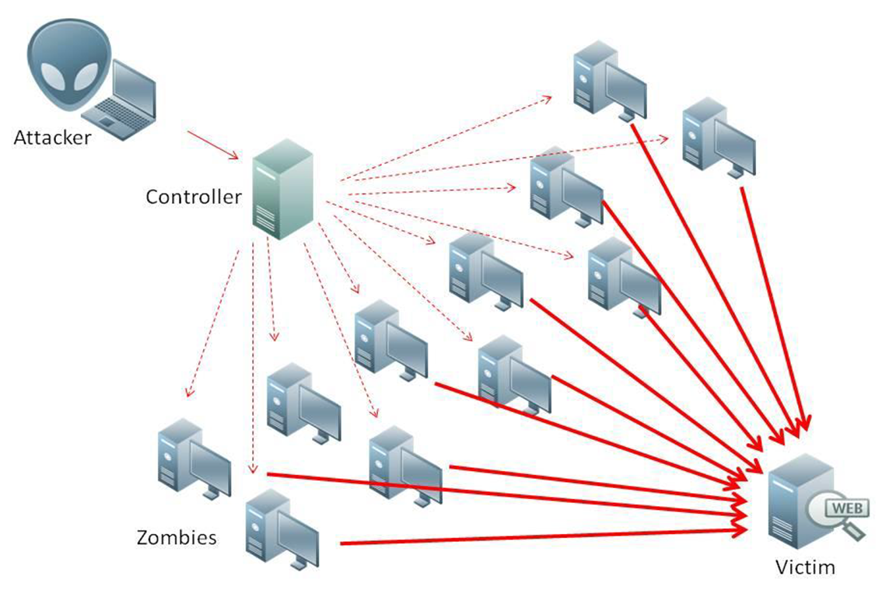
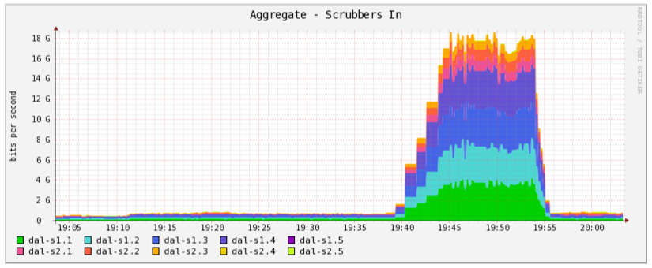
Distributed Denial of Service (DDoS)

Slide 17
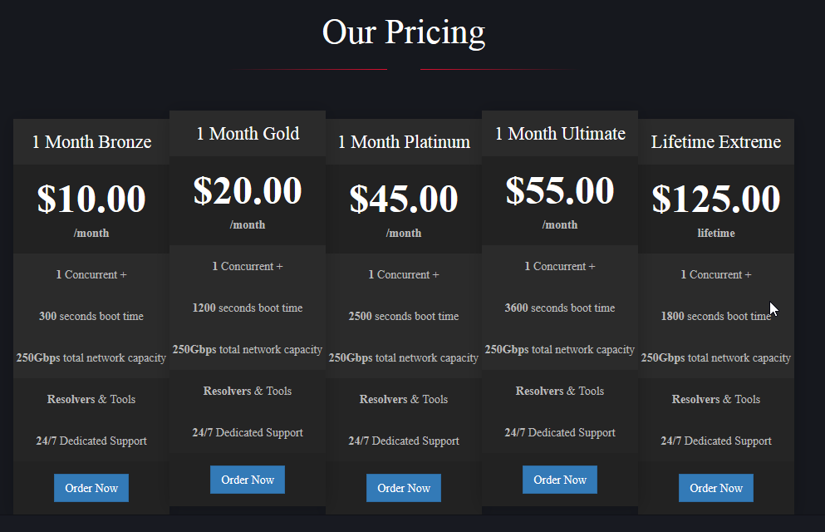
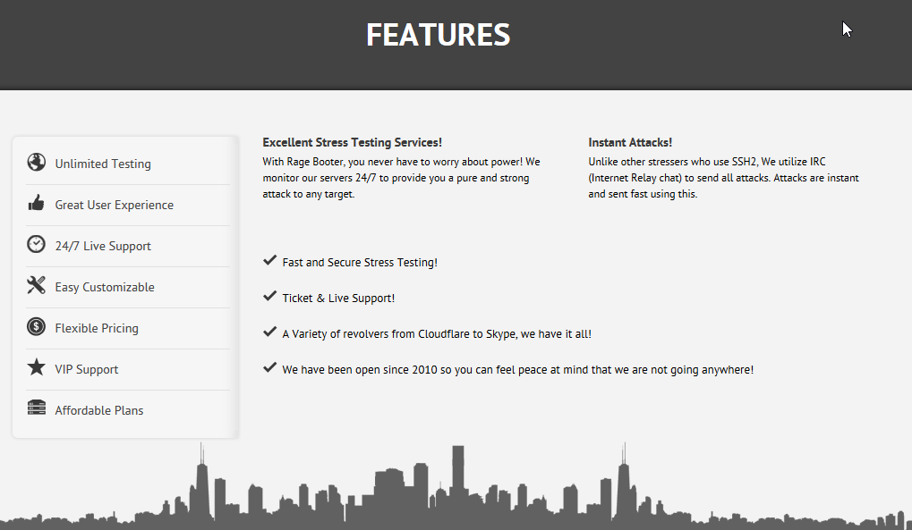
Distributed Denial of Service (DDoS)
Network Stressers

Slide 18
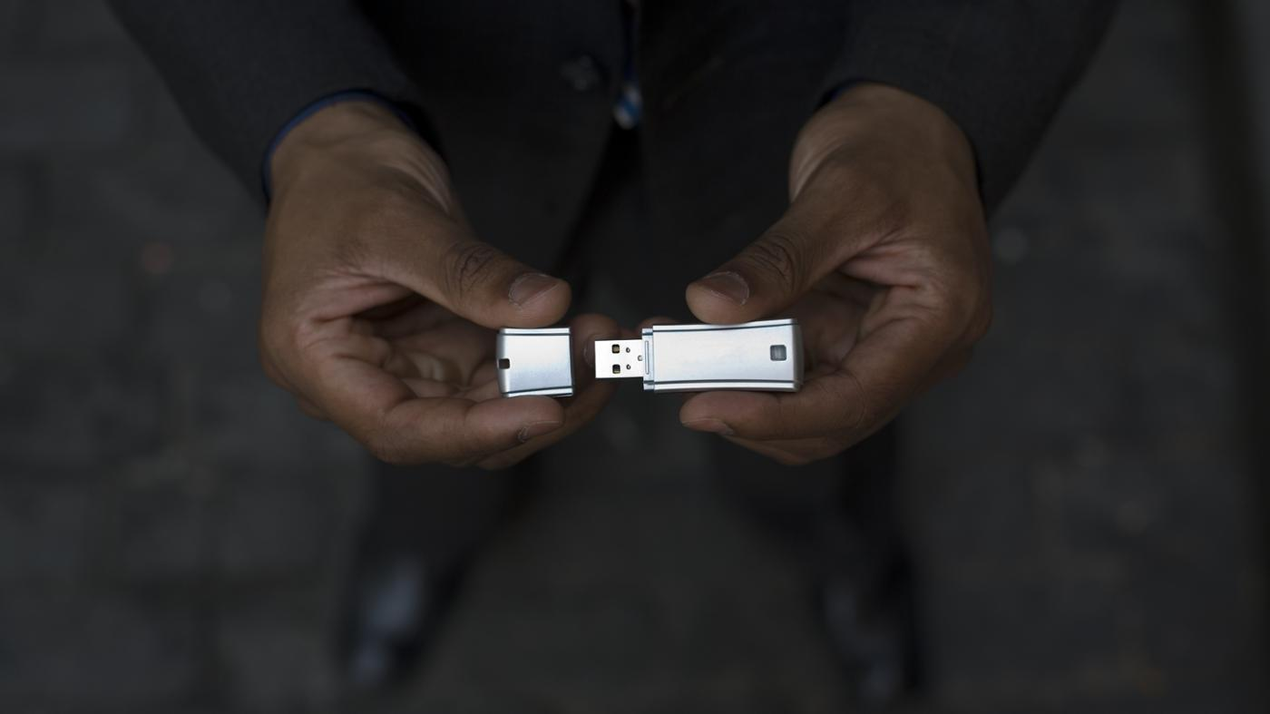
“Lost”
USB Stick

Slide 19








Firmen Netzwerk
Internet

Slide 20

Vishing &
SMShing

Slide 21
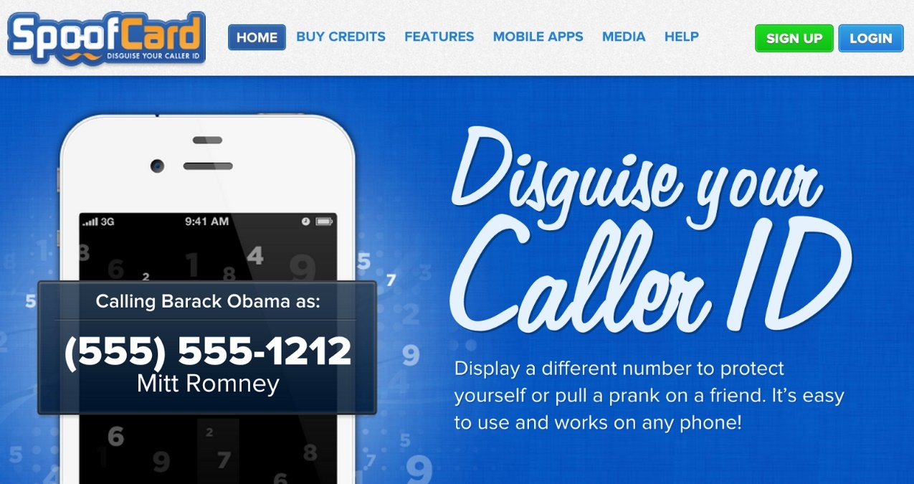

Caller ID Spoofing

Slide 22

Countermeasure

Slide 23
Prevention for enterprises
Raise awareness about security and computer threats in the enterprise
Teach collaborators through an internal security course
Establish clear guidelines for social medias
Encrypt sensitive data
Keep the protection systems for hard- and software up to date
Enforce good practices for passwords
Backup your data

Slide 24
Prevention for individuals
Different password for each online service
Use a password manager
Update your software on a regular basis (OS, browser , Java, Flash, …)
Use a recent and up-to-date antivirus
Be careful with every incoming email (Phishing?)
Don’t blindly trust the sender of E-Mail, SMS, whatsapp, etc…
Backup your data

Slide 25


Slide 26

Cybercrime is highly organized
and
profit oriented

Slide 27
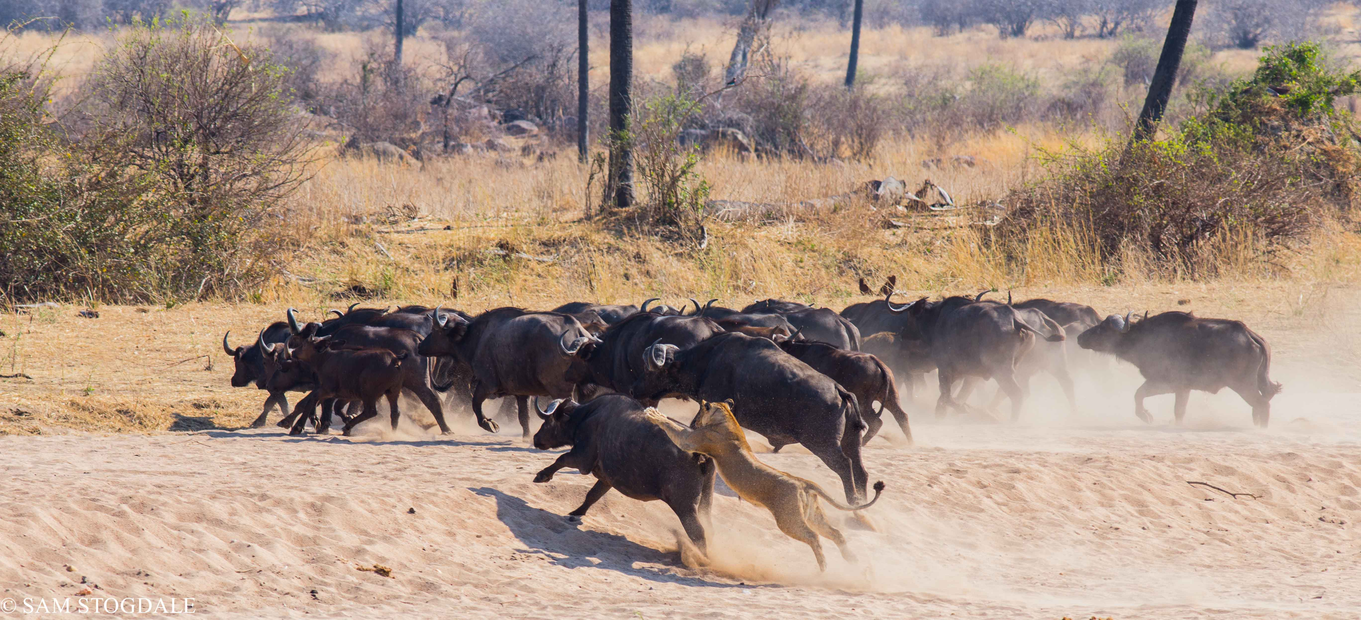
They will go after easy and profitable target

Slide 28

Don’t be the low-hanging fruit!

Slide 29


